Slide 1
Salford Racing Engineering team meeting
Wednesday 18th October
Henry Fielding - Engineering Director
Notes:
Attendance,
Team Membership
iMechE Membership
Take notes
Inspiration

Slide 2
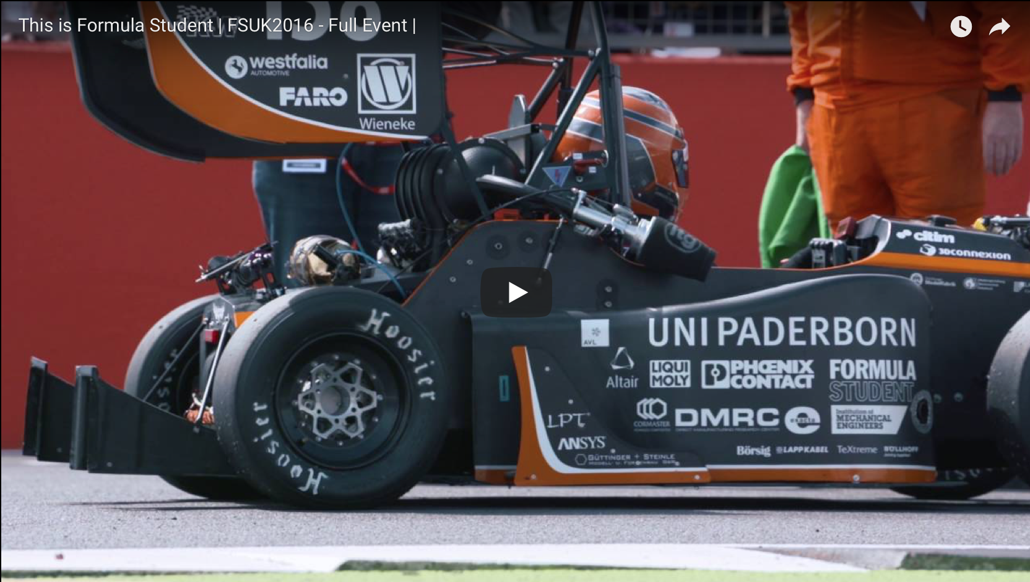

Slide 3
Rebrand
Social Media
Google Drive
Available Software
Formula Student
Rules
Winning Car
Design Key Points
Team Structure
Team Roles
Team Attitude and final remarks

Slide 5
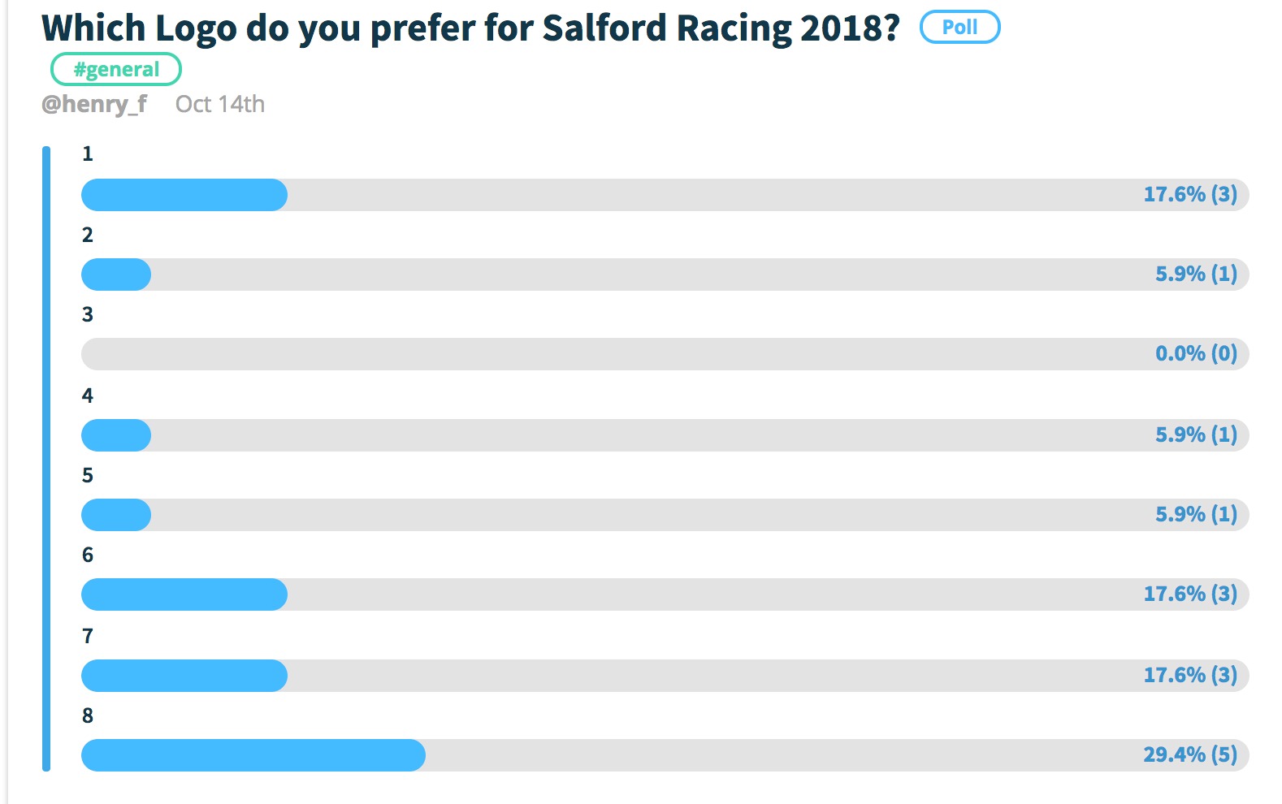

Slide 6


Slide 7

Website Running

Slide 8
Twitter

Slide 9
Facebook

Slide 10
Google Drive

Slide 11
MATLAB and Simulink

Slide 12
Solidworks

Slide 14
Formula Student run-through
All here because of Formula Student
Design, Build, Race
Compete
Win
Started in America in 1980 - FSAE – Formula Society of Automotive Engineers
Formula Student – iMechE

Slide 15
Formula Student run-through
Class 1
This is a concept class for teams who only have a project and plan for a Class 1 car.
It can include any parts or work that has been completed in the project so far but this is not necessary. Teams are judged on business presentation, cost and design.
Class 2
This is the main event, where teams compete with the cars they have designed and built.
Teams are judged across 6 categories and must pass a rigorous inspection by judges before being allowed to compete for the dynamic events. There are usually 100-120 teams in this class.

Slide 16
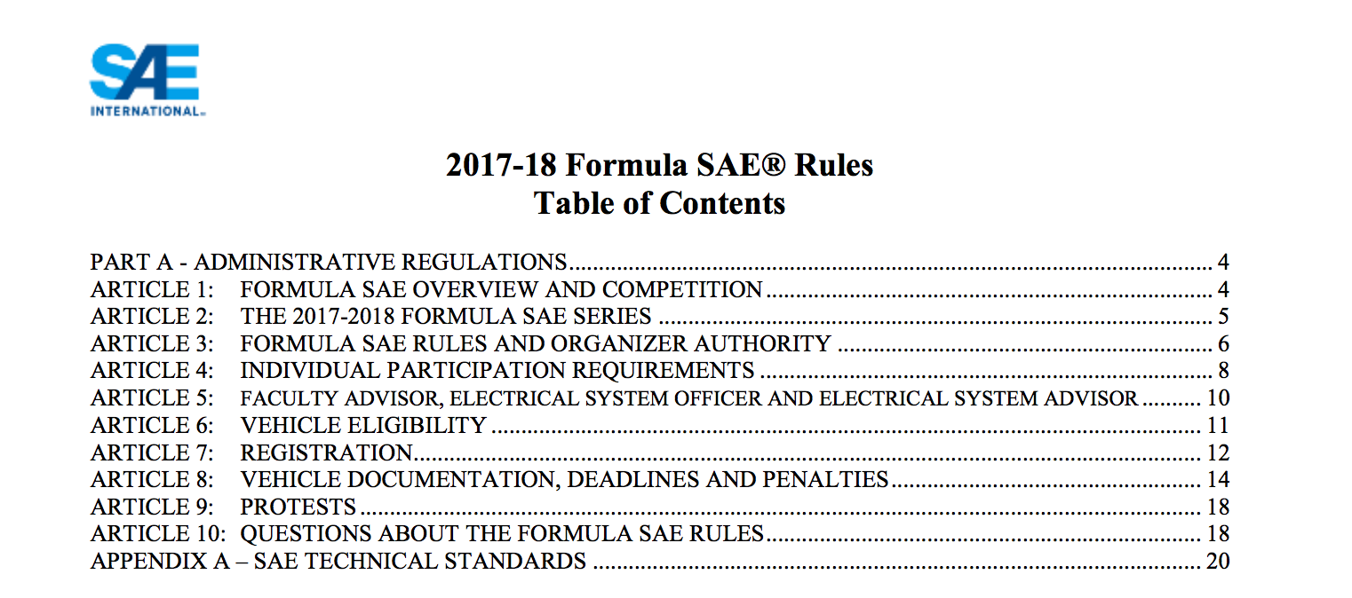
Formula Student Rules
Rules originate From FSAE

Slide 17
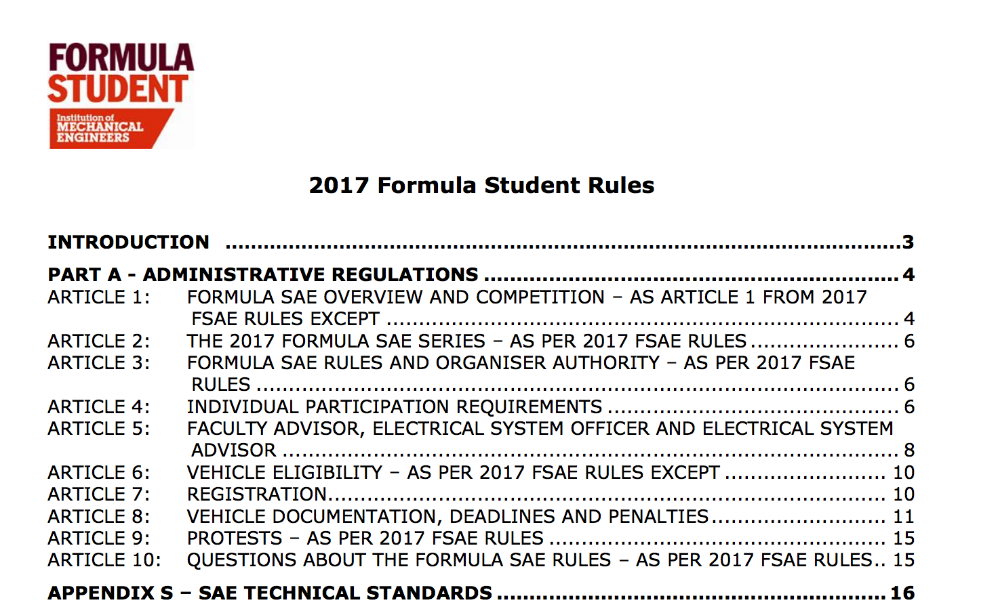
Formula Student Rules

Slide 18
Formula Student Rules
Electric

Slide 19
Formula Student Rules
Internal Combustion

Slide 20
Formula Student – Static Testing
Engineering
Engineering Design (150 points)
Technical Inspection (Scrutineering): Safety, Chassis, Noise, Tilt, Brake, and Tech
Business
Cost & Sustainability Analysis (100 points)
Business Presentation (75 points)

Slide 21


Slide 22
Formula Student – Dynamic Testing
Engineering
Skidpad (Figure of 8) (50 points)
1 km Autocross/Sprint (150 points)
75m acceleration (75 points)
22 km endurance (300 points) and fuel economy (100 points)

Slide 23
Formula Student – Summary

Slide 24

Competitor Cars
Body | Aluminium monocoque / rear spaceframe
Brakes | Custom 188mm steel discs
Calipers | Front - Brembo P2-34, Rear - AP Racing CP4226
Suspension | Front push rod Fox Van RC dampers with Coil Springs
 | Rear push rod Fox Van RC dampers with Fox Float heave spring
Tyres | Avon A92
Wheels | 3 piece, Keizer rims and centres
Engine Name | Triumph 675 Street Triple
Engine type | DOHC fluid cooled three cylinder four-stoke, running on E85
Engine Capacity | 675 cc
Bore & Stroke | 75 x 52 (mm)
Compression Ratio | 12.9 : 1
Inlet | Laser sintered plenum
Injection | Keihin KN6
Exhaust | Student designed twin mufflers mixed absorbative and reactive noise reduction
Drive Train | Drexler differential
Final Drive | 3.8:1
Length | 2835mm
Width | 1368mm
Height | 1175 mm
Wheelbase | 1560 mm
Track | 1190 / 1120 mm

Slide 25


Slide 26
Key Points for Design
Simplicity
Reliability
Rule Compliance

Slide 27
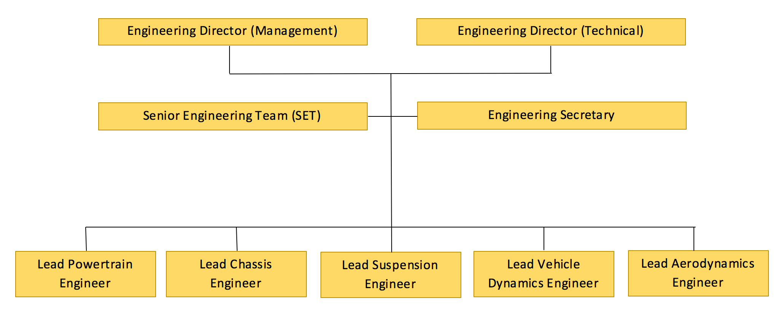
Engineering Team Structure

Slide 28
Teams
Aerodynamics
Guillaume Dorland
Powertrain
Hamza Iqbal
Ben Beckert
Ahmed Rehmet
Hamza Javaid
Jac Nelligan
Suspension
James Johnson
Sohaib Hussain
Dynamics
Ryan Owen
Alex Miller
Chassis

Slide 29
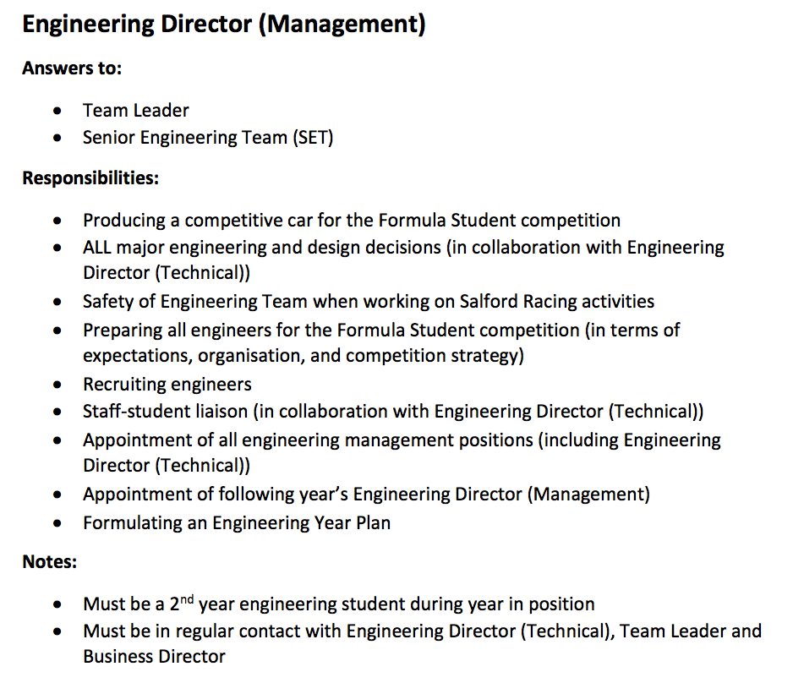

Slide 30
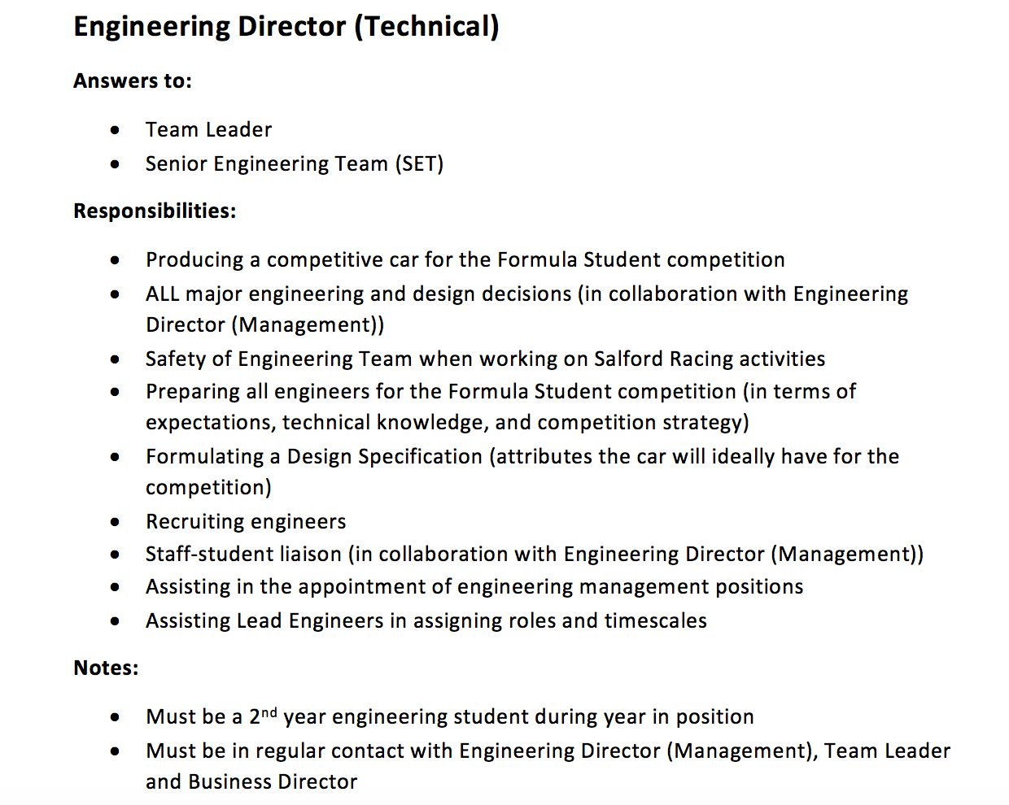

Slide 31
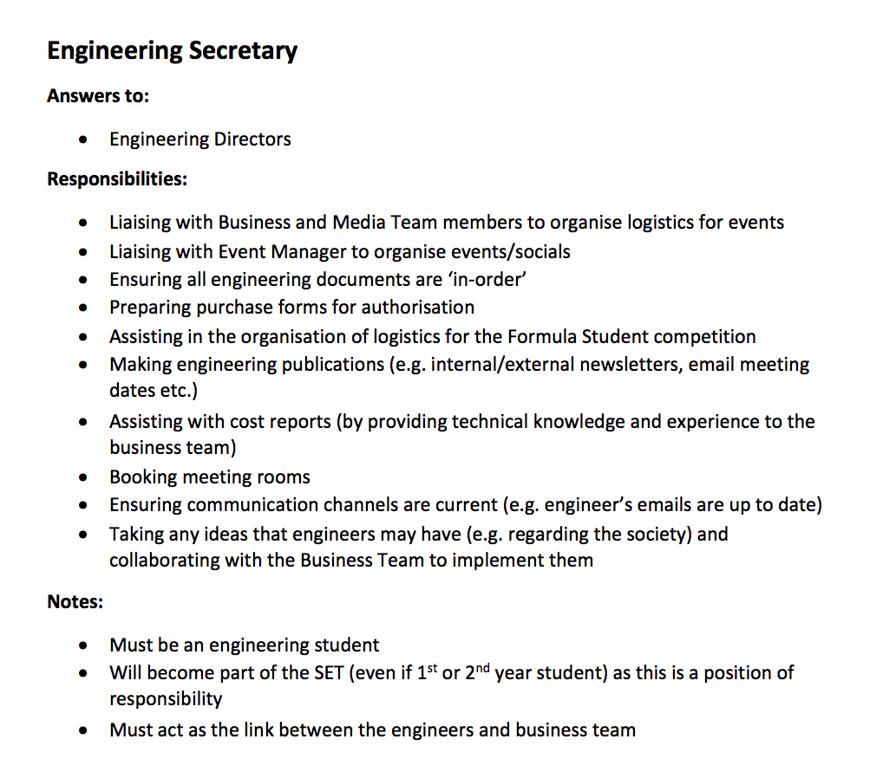

Slide 32
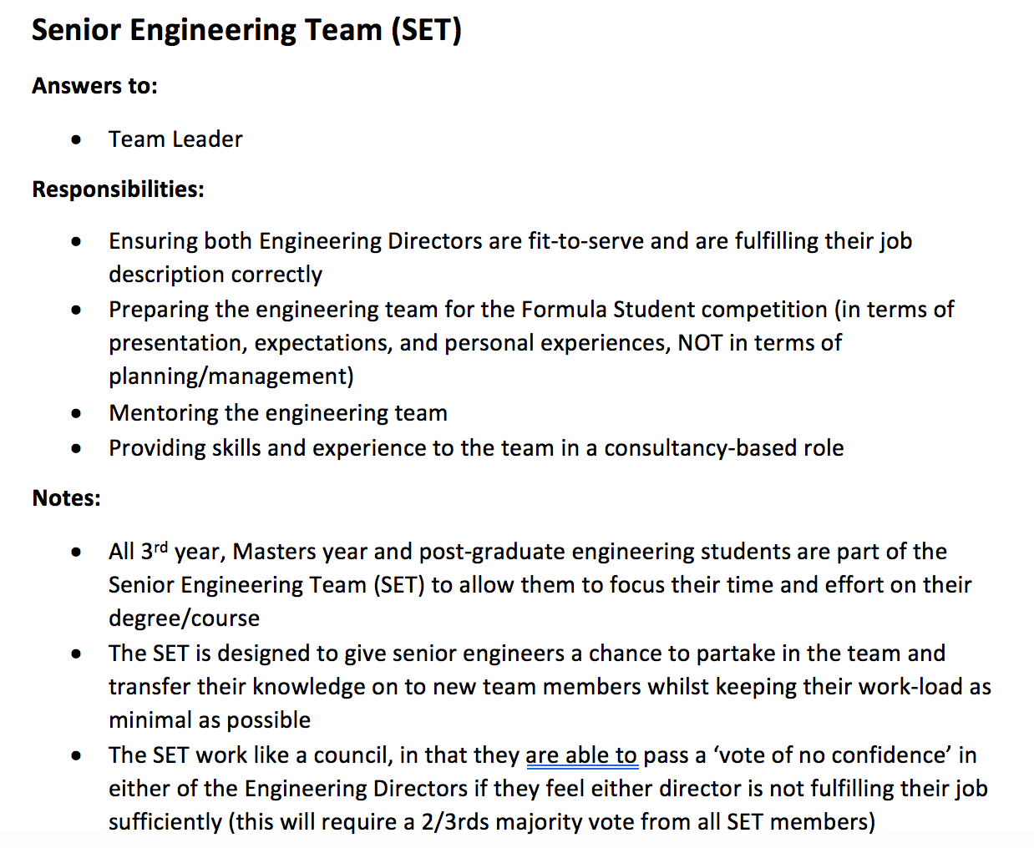

Slide 33
Engineering Team Structure

Slide 34
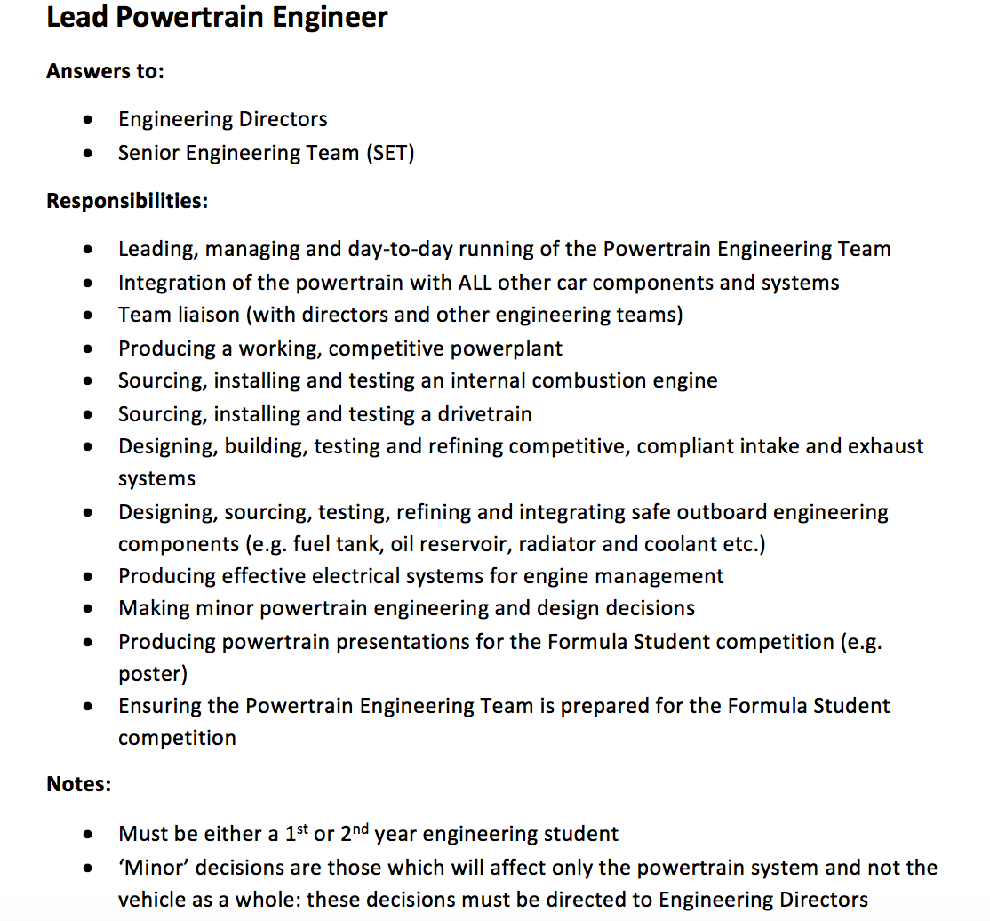

Slide 35
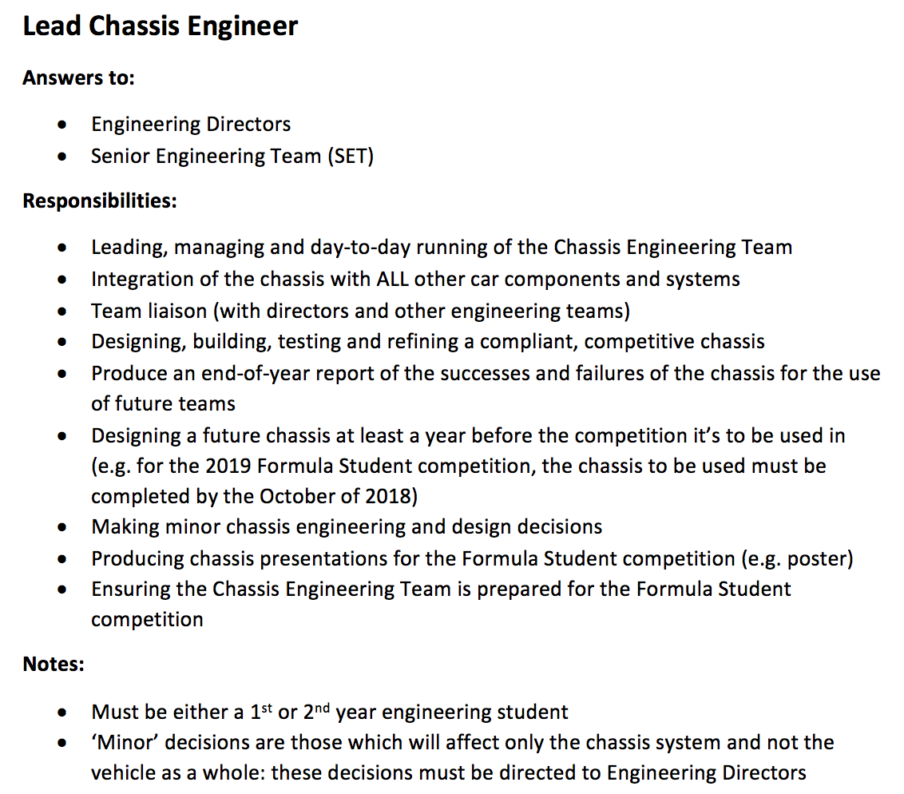

Slide 36
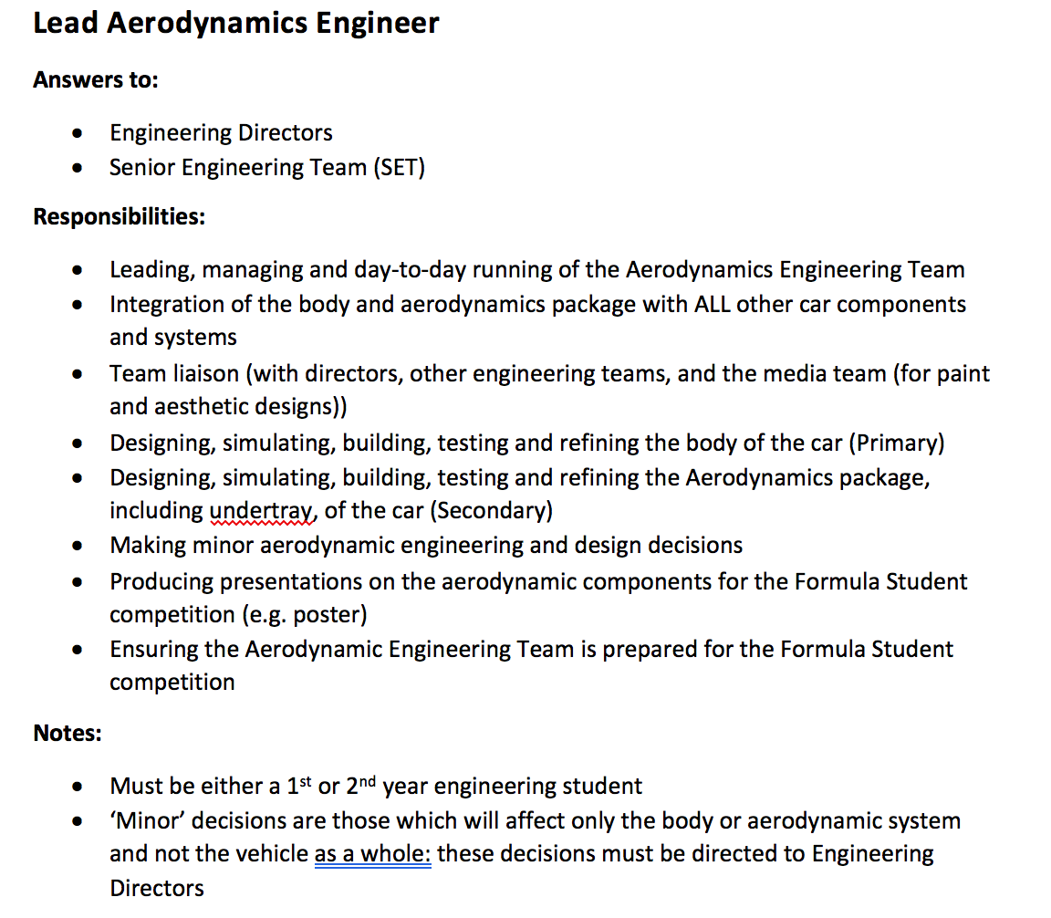

Slide 37
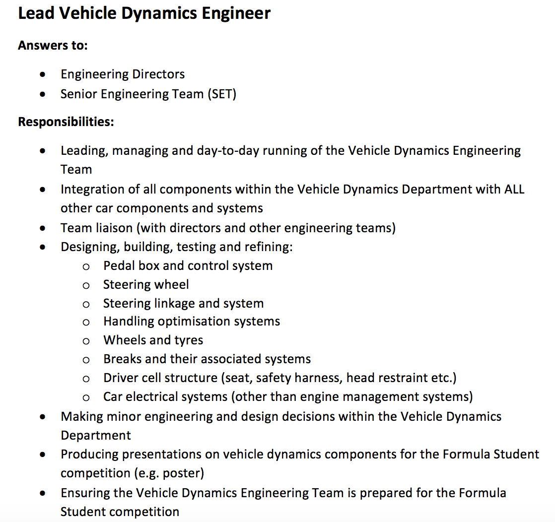

Slide 38
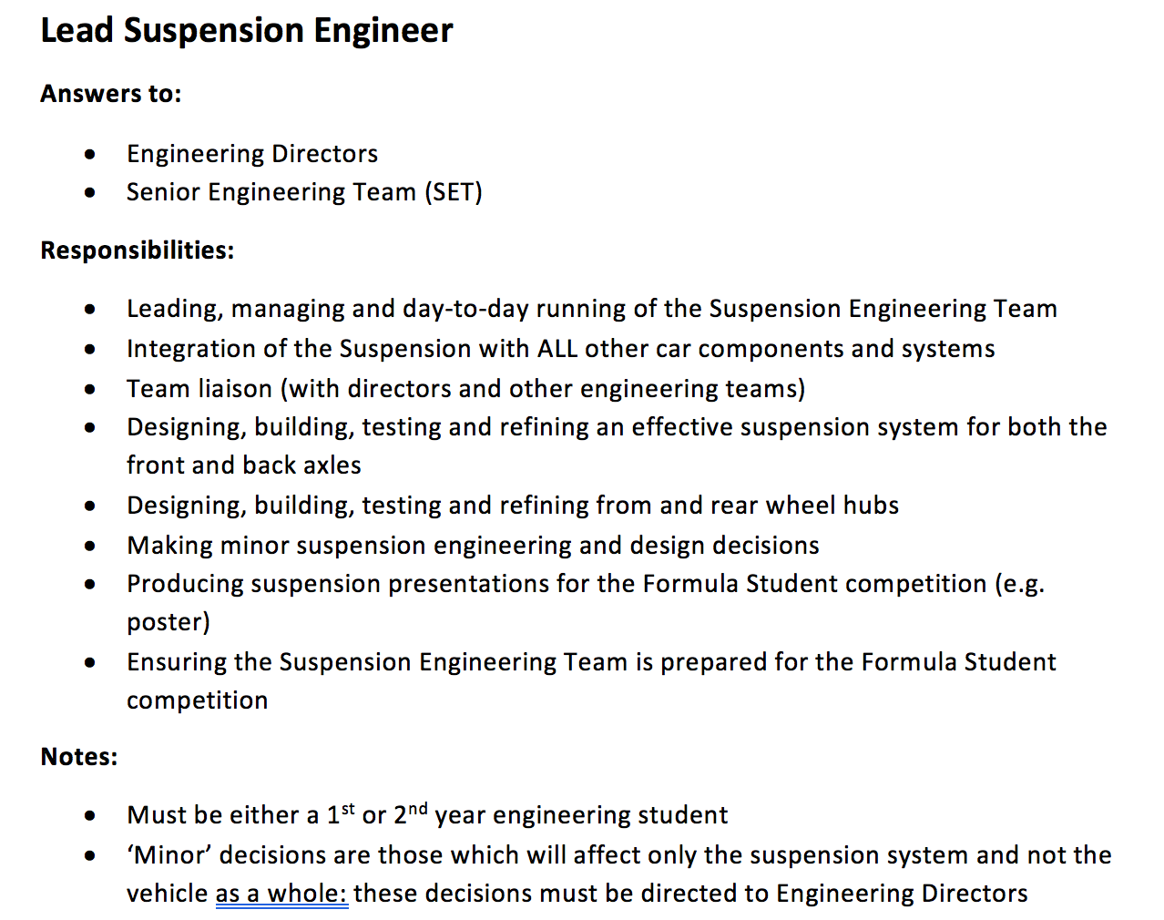

Slide 39
Overall Remarks - Attitude
Enormous amount of effort and support needed to meet goal.
Increased pace of work required.
Get yourself inspired
Attitude of Enthusiasm
Don’t wait around to be told to do something
Ask questions
Put forward ideas
Can I do more?

Slide 40
Overall Remarks - Attitude
No Place in this society for someone that is Lazy
Management is always watching
Attend meetings

Slide 41
Thanks

